Slide 1
Complexity-based Economic and Production Analysis: Overview and Country Report
With analysis for Brazil, China, Egypt, France, Germany, Japan, Malaysia, Mexico, Morocco, South Africa, South Korea, Spain, Turkey, UAE and USA
Heyang Huang, Soulaymane Kachani, Lun Li, Jiayu Zhao
Columbia University

Slide 2
Contents
1. Overview
2. Economic Complexity Framework
3. Production Analysis
4. Product Space Design
5. Macro-level Predictions
6. Reference
7. Appendix

Slide 3
1. Overview
With an increasing volume of international trade, countries are more specialized than ever in production and have diversified into distinct production patterns
Based on global export data available to us, in this report we examine countries’ growth paths and product spaces on a complexity level, during the period from 2009 to 2014
The rest of the report is organized as follows:
Section 2
Countries’ economic complexity is quantified the same way as defined by Hausmann and Hidalgo (2009)
Section 3
Products are grouped into industry families and the growth paths adopted by countries during the period are closely examined
Section 4
Analyses are conducted on countries’ sequential development strategy, sensitivity to industry upheaval and the contingency plan
Section 5
Macro-level results are used to assess countries’ structural optimality
Section 7
Country-specific results are available for further reviews

Slide 4
2. Economic Complexity Framework
2.1 Economic Complexity
2.2 Production Matrix
2.3 Diversity and Ubiquity
2.4 Economic & Product Complexity Index
2.5 Proximity and Distance
2.6 Opportunity Gain

Slide 5

2.1 Economic Complexity
In the era of globalization, more and more economies decide to specialize in the production. The global market and international organizations allow the knowledge that is held by the few to reach many.
Global Market
Productive Knowledge
Productive Knowledge
Productive Knowledge

Slide 6
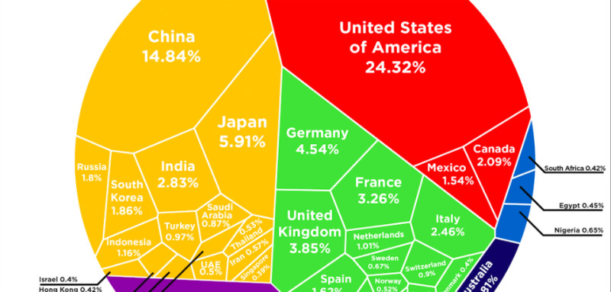
2.1 Economic Complexity
Meanwhile, the uneven distribution of productive knowledge is widening gap between rich and poor economies. The uneven distribution is expressed in the diversity and sophistication of products the economies produce.

Slide 7
2.1 Economic Complexity
There are two types of productive knowledge:
Explicit Knowledge
that can be transferred easily by reading and listening
Weather forecast
Bus schedule
Tacit Knowledge
that requires a systematic and time-consuming learning process to transfer
Semiconductor Manufacturing
Shell oil drilling
History of a building
Foreign Language
A lack of crucial tacit knowledge is the hindrance that an economy faces in its development and growth

Slide 8
2.1 Economic Complexity
Products are made of raw material with the support of capital and machinery. However, from the perspective of Economic Complexity:
Products are made of pieces of productive knowledge
Water, pigment substance, and glass
Manufacturing Machinery
How to control the tinting strength of pigments
How to mass produce glass bottles

Slide 9
2.1 Economic Complexity
The complexity of an economy is related to the multiplicity of useful knowledge embedded in it.
Economic complexity, therefore, is expressed in the composition of a country’s productive output and reflects the structure that emerges to hold and combine knowledge

Slide 10
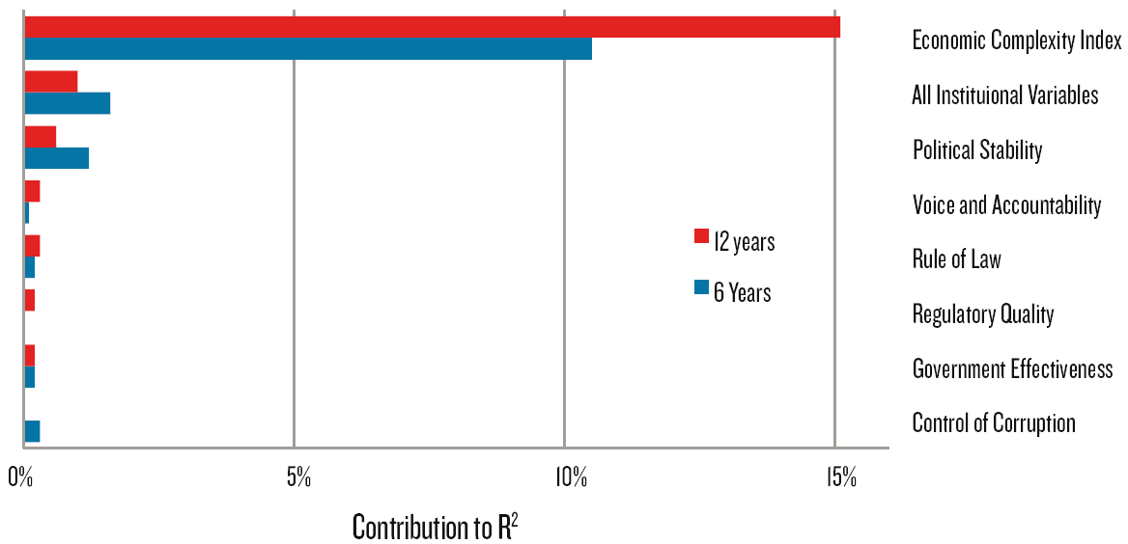
2.1 Economic Complexity
The economic complexity more effectively captures growth relevant information than the six world governance indicators.

Slide 11
2.2 Production Matrix
When consider which products play important roles in a country’s production, we should take into account of the export volume of the country and that of the product in the world trade.
In other words, we should use comparative advantage instead of absolute advantage as our criterion.

Slide 12
2.2 Production Matrix
Balassa defines Revealed Comparative Advantage (RCA) as“a country has Revealed Comparative Advantage in a product if it exports more than its “fair” share, that is, a share that is equal to the share of total world trade that the product represents.”
Accordingly, we define the matrix of comparative advantage in production for countries and products. “1” indicates the advantage, while “0” indicates the opposite

Slide 13




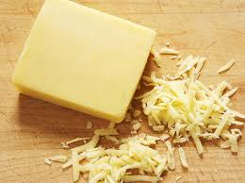

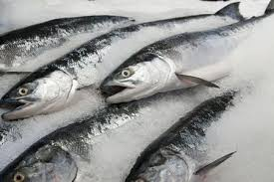
2.3 Diversity and Ubiquity

Slide 14
2.3 Diversity and Ubiquity
Diversity measures how many products a country can produce
Ubiquity measures how many countries are capable to produce a product
The Diversity and Ubiquity are a pair of complements and can be used to iteratively correct each other

Slide 15
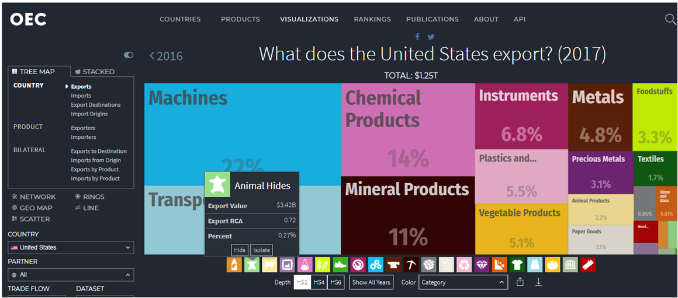
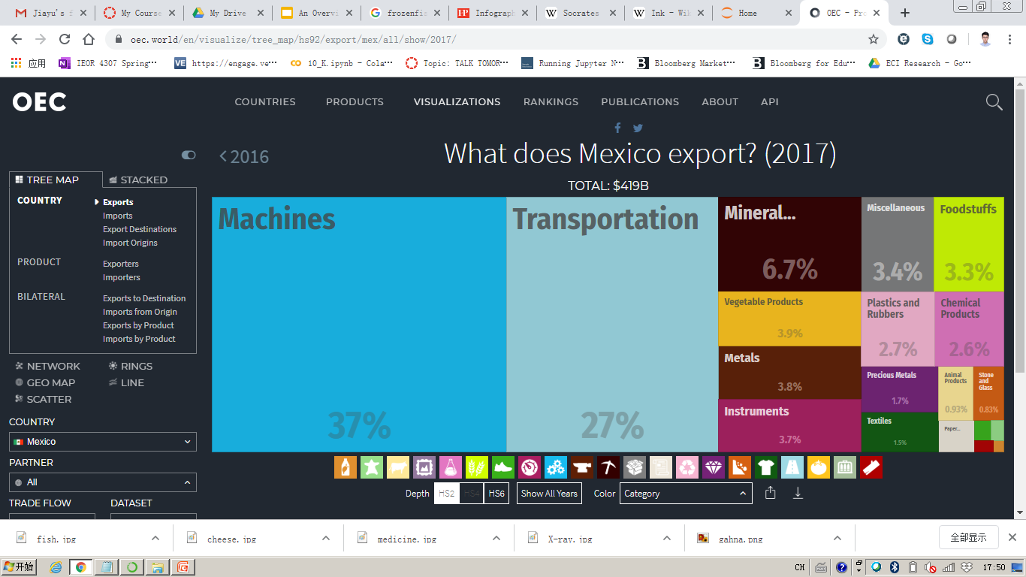
2.4 Economic & Production Complexity Index
Countries specialize in different industries with distinct level of productivity

Slide 16
2.4 Economic & Production Complexity Index
Products
Connectedness
Integrated Circuit
Weapon Parts
Computers
Bovine Meat
High complexity products are connected with a large amount of products
High complexity products are close to other products with high complexity

Slide 17
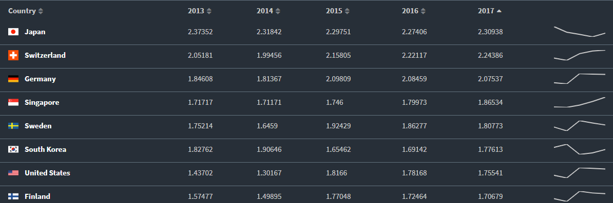
2.4 Economic & Production Complexity Index
From the trend of Economic Complexity Index in nearby 5 years, we can have a rough picture of whether the countries are on the right track of economic development.

Slide 18
2.4 Economic & Production Complexity Index
The second largest eigenvector of M_{cc} best preserves the information about variance in the system, which is just Economic Complexity. Hence, we define the Economic Complexity Index ( ECI) as:
Where <> stands for numeric mean, and stdev stands for the standard deviation.
Similarly, we can calculate the second largest eigenvector of M_{pp’,} and define Product Complexity Index ( PCI) as
Where<> stands for numeric mean, and stdev stands for the standard deviation.

Slide 19
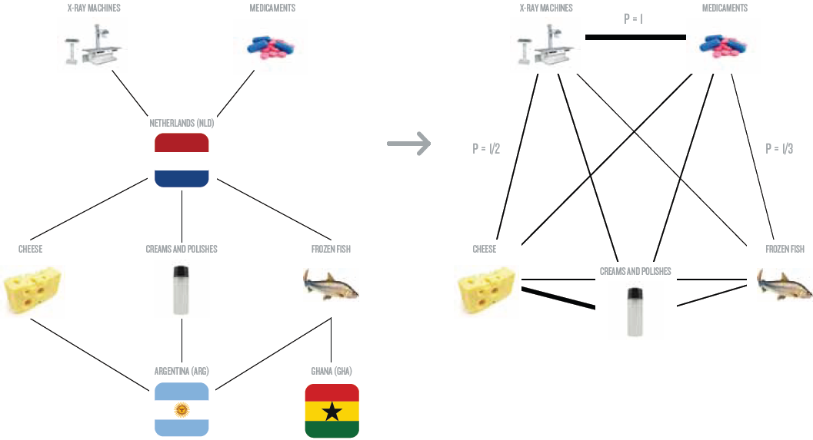
2.5 Proximity&Distance
Derive Proximity

Slide 20
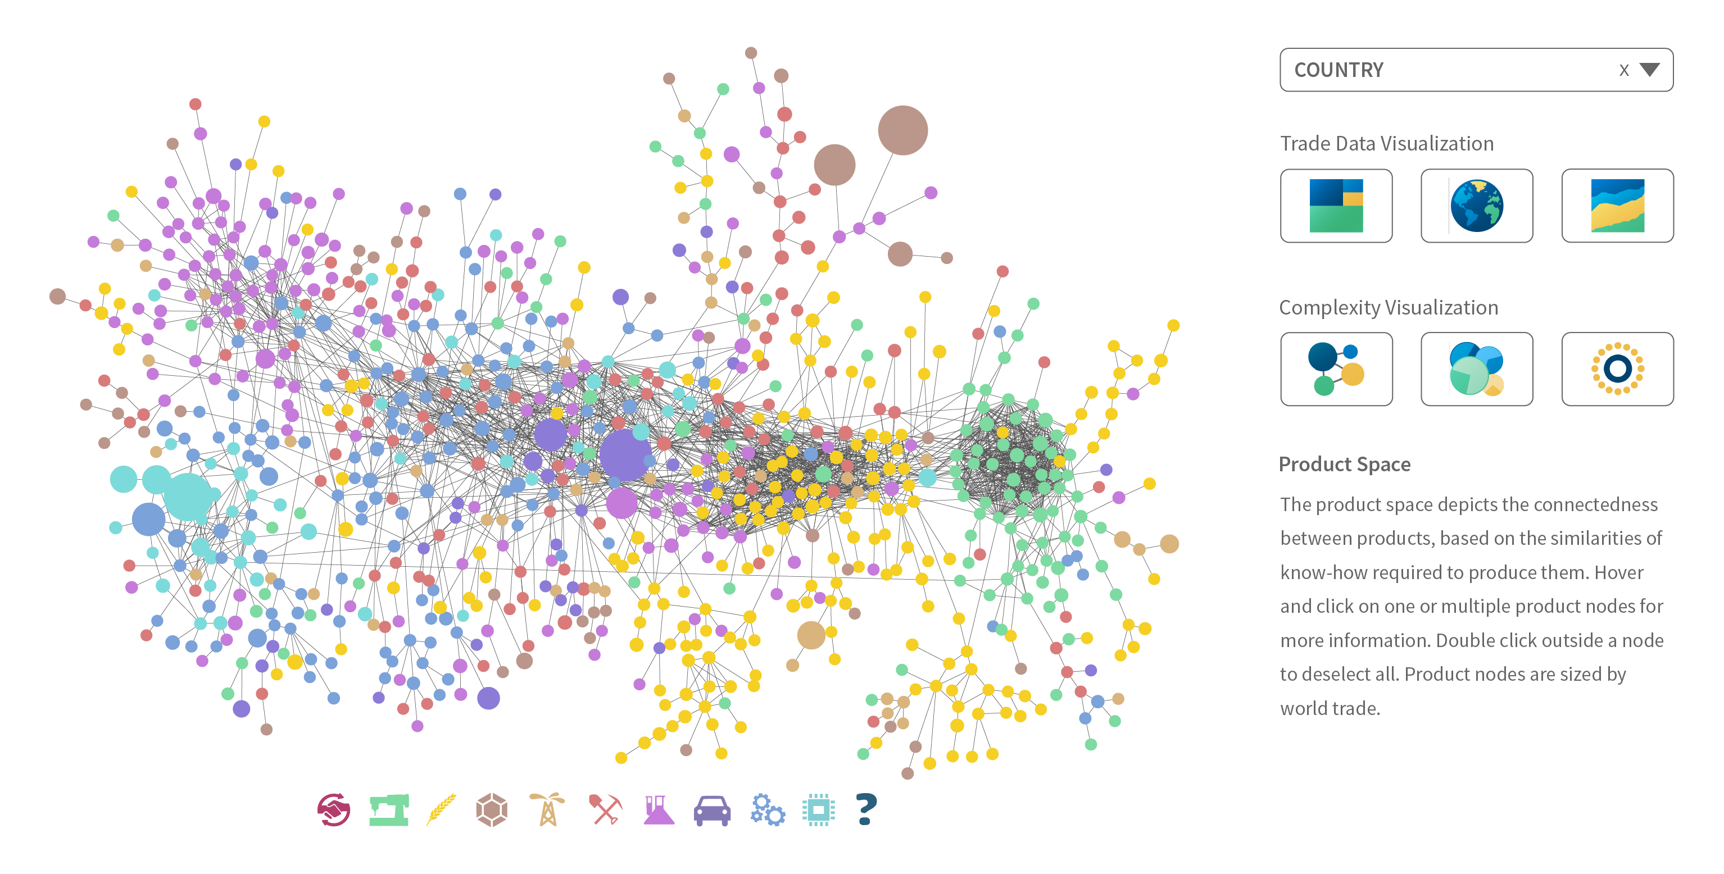
2.5 Proximity&Distance
Certain products are composed of similar productive knowledge. We define connectedness of z product as the numeric average of proximity of it to all other products
We define the smaller conditional probability of exporting product p given the country is currently exporting product p’ and that of exporting p’ given the country is exporting p, as proximity. We then normalize Proximity as Distance

Slide 21
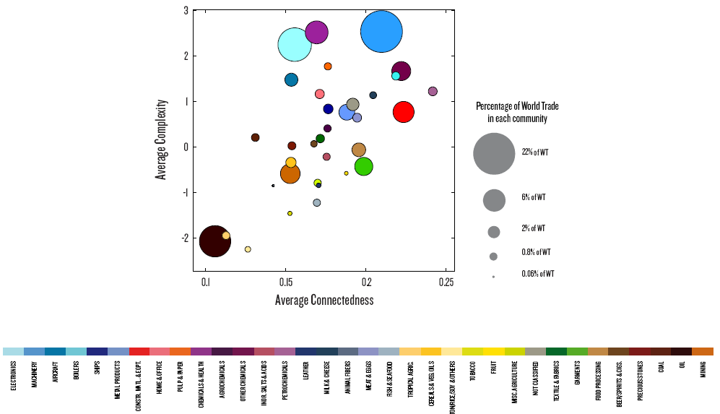
2.6 Opportunity Gain
While the product space gives us a glimpse of productive knowledge embedded in an economy,
we are still in need of a quantitative measure of the opportunity those productive knowledge implies.
We define this measure as opportunity value.

Slide 22
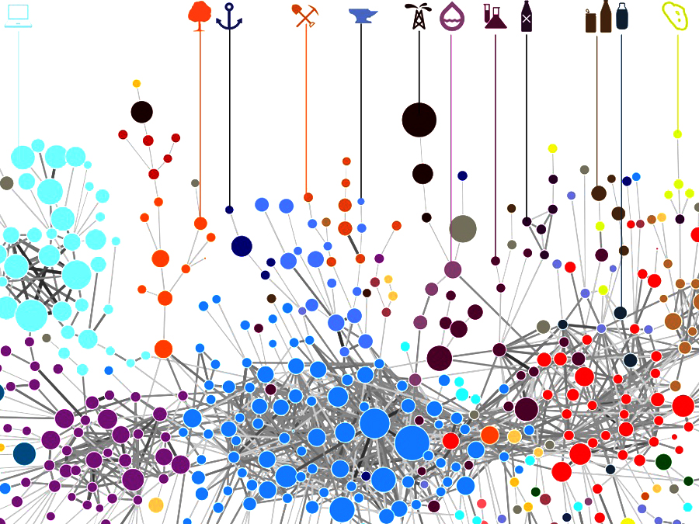
2.6 Opportunity Gain
The profit of exploring a new product is defined as the decrement of Distance to all other products far away from the product space.The Distances are weighted by the complexity of products respectively
However, the low complexity and connectedness of a product can also incur a cost that needs to be deducted from the opportunity gain

Slide 23
3. Production Analysis
3.1 Product Categorization
3.2 Actual Development Index
3.3 Regional and Global Comparison

Slide 24
3.1 Product Categorization
Product groups in UN Comtrade are labelled from 010000-999999, with the first two-digits representing a category to which the product belongs
From the 99 categories as extracted from the label, we further group the products into 18 major and widely-accepted industry categories
High-tech is an aggregated industry that indicates the most complicated products from the most technologically-advanced industries, as measured by PCI, and in regression it explains over 67.6% of countries’ GDP
Animal and By-product Raw Manufacturing Transportation Vegetable, Fruit and Plant Wood Product Weapon Food and Preparation Clothing and Accessory Daily Instrument Mineral and Stone Textile Precious Stone Chemical Metal Service Chemical Manufacturing Machinery High-tech

Slide 25
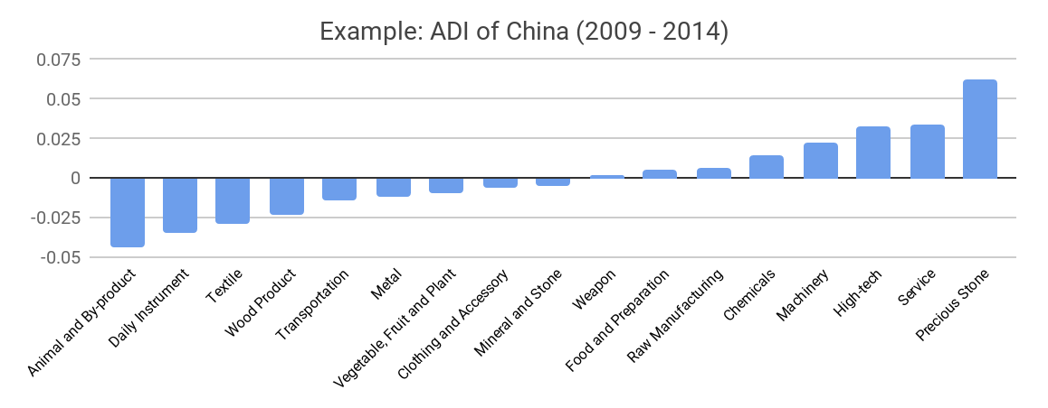
3.2 Actual Development Index
Based on this concept of distance between countries and product families, we defining the net distance change between two periods as the Actual Developmental Index (ADI)
ADI measures by how much a country has moved in the direction of a certain product family in its product space during the period, and is a relative concept

Slide 26
3.3 Regional and Global Comparison
It can be observed that leading economies, such as U.S. and Germany, in general focus on products with higher level of complexity
Reasonably, emerging economies such as China, South Korea, Singapore and India have devoted the majority of their efforts into intermediate industry groups
Chemical Manufacturing
Machinery
Chemicals
Precious Stone
USA
China
Service
Wood Product
Transportation
Daily Instrument
Germany
India
High-tech
Chemicals

Slide 27
4. Production Space Design
4.1 Suggested Development Vector
4.2 Sequential Development Strategy
4.3 Sensitivity Analysis
4.4 Contingency Plan

Slide 28
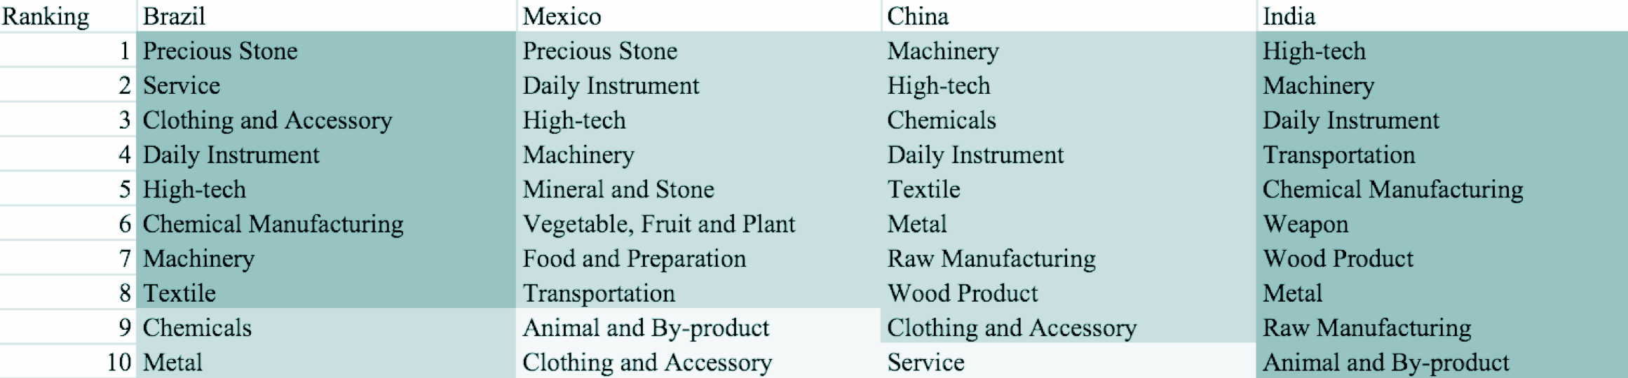
4.1 Suggested Development Vector
We define the ranking of opportunity gain of a country as the Suggested Development Vector (SDV) of the country
Leading economies are typically well-shaped and barely have any industries with positive opportunity gain, while emerging economies need a sequential strategy that allows for prioritization of certain industries

Slide 29
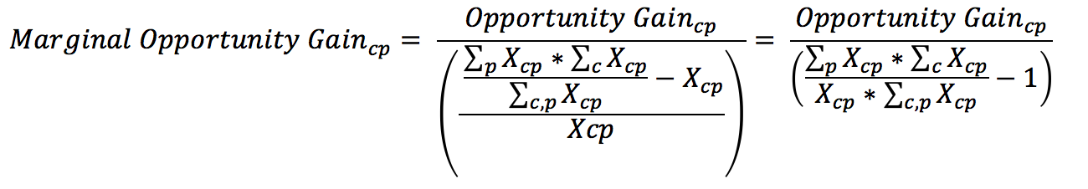
4.2 Sequential Development Strategy
As the difficulty of bumping up MCP varies across industries, we need to capture this variation of difficulty by defining the concept of marginal opportunity gains as follows
In each iteration, we order all 18 industries based on their current marginal opportunity gain, and prioritize the industry with the highest marginal opportunity gain
We then increase the prioritized industry’s export to an extent that the MCP firmly bumps up to 1, and re-perform calculations to prioritize the next industry

Slide 30
4.2 Sequential Development Strategy
Calculated using the sequential strategy algorithm, the example of Morocco shows how the prioritization of a developing country evolves from basic products to intermediate-level products

Slide 31
4.3 Sensitivity Analysis
The sensitivity analysis aims to approximate the volatility of SDV subject to an increment or decrement of export and is mainly implemented on developed countries that
have few industries with positive opportunity gains.
To be more specific, sensitivity score is the least-squared slope for the linear regression between percentage change of production and that of the E _{f} CI
We perform the sensitivity analysis of the aggregate of top ECI countries, including US, UK, Korea, Japan, South Korea, Singapore, Germany, and France, and use the result as the benchmark. The sensitivity score in 2014 and 2009 are shown below:
Sensitivity Score (2014)
 | High-tech | Food and Preparation
Decremental | 1.676 | 0.007
Incremental | 1.195 | -0.006
Sensitivity Score (2009)
 | High-tech | Food and Preparation
Decremental | 1.514 | -0.001
Incremental | 1.294 | 0.007
Sensitivity Score of Benchmark in 2014
Sensitivity Score of Benchmark in 2009

Slide 32
4.4 Contingency Plan
The Contingency Plan presents solutions to productivity decline within specific industries. Sometimes, the optimal solution to such downturns is not to invest in the industries undergoing downturns directly, but to support industries highly connected to such industries.
Contingency Plan (2014)
 | 0 | 1
High-tech | Animal and By-product | Precious Stone
Service | Service | Precious Stone
Contingency Plan (2009)
 | 0 | 1
High-tech | Mineral and Stone | Precious Stone
Service | Mineral and Stone | Precious Stone
Contingency Plan of Benchmark in 2014
Contingency of Benchmark in 2009

Slide 33
5. Macro-level Predictions
5.1 Structural Optimality Index (SOI)
5.2 SOI Examples and Implications

Slide 34
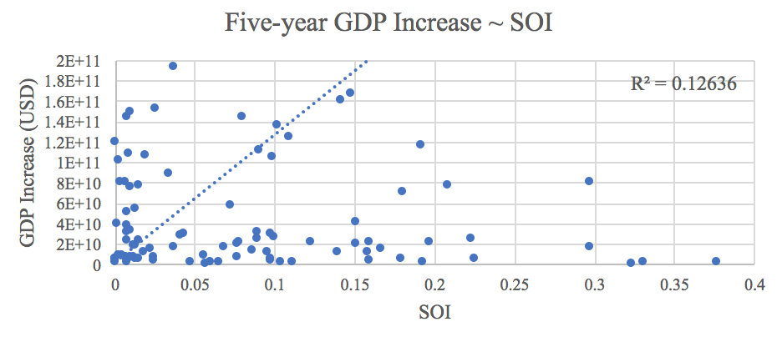
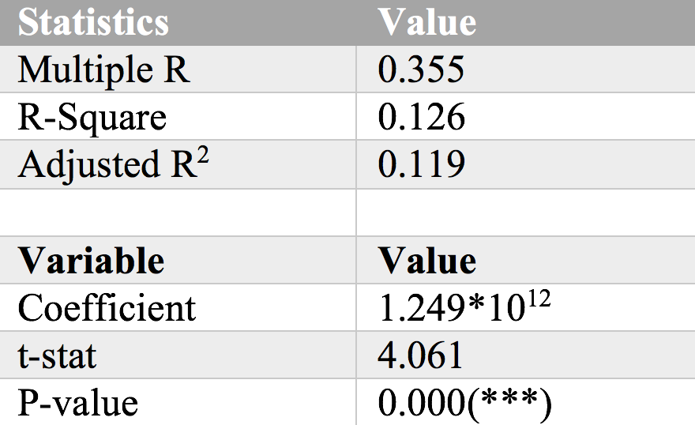
5.1 Structural Optimality Index (SOI)
Structural Optimality Index (SOI) is defined as the adjusted R-Square of export increase in industries ~ opportunity gains of industries
SOI provides a quantified measure of how the development path adopted by a country fitted with/differed from calculations on a complexity level (i.e., the opportunity gains)
We further observe a significant correlation between SOI and five-year GDP increase of countries, indicating that structural optimality does impact economic outcomes

Slide 35
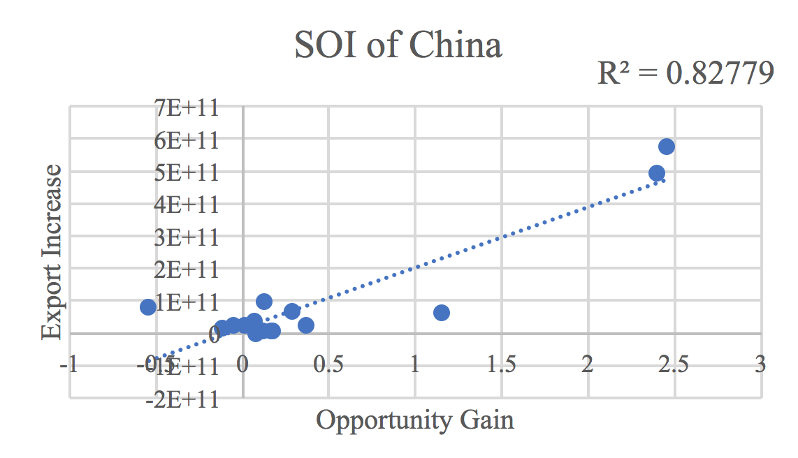
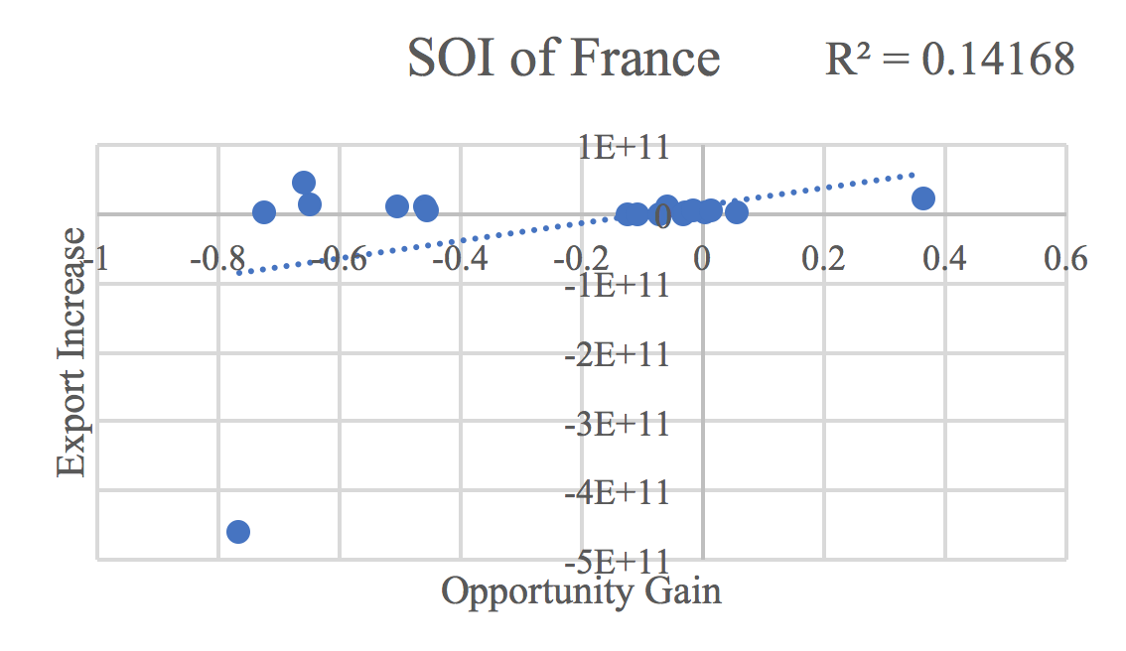
5.2 SOI Examples and Implications
Taking China and France for comparison, China ranks the 1st place among all countries in terms of SOI (82.8%), and has the highest economic growth rate from 2009 to 2014
In contrast, developed economies such as France, where there is a moderate SOI of around 14.2% and a corresponding annual growth rate of 1.1%
Intermediate-term economic progress can be at least partially explained by the optimality of development strategy that countries choose to adopt

Slide 36
6. Reference
Hausmann, R., Hidalgo, C., Bustos, S., Coscia, M., Chung, S., Jimenez, J., Simoes, A. and Yıldırım, M. (2007). The Atlas of Economic Complexity. [online] Atlas.cid.harvard.edu. Available at: http://atlas.cid.harvard.edu/.
Comtrade.un.org. (n.d.). Download trade data | UN Comtrade: International Trade Statistics. [online] Available at: https://comtrade.un.org/data/.

Slide 37
7. Appendix
In this section we outline the most important calculations & analysis results for a selected group of countries, including Brazil, China, Egypt, France, Germany, Japan, Malaysia, Mexico, Morocco, South Africa, South Korea, Spain, Turkey, UAE and USA
For each country, we highlight its GDP & ECI trend, Actual Development Index (ADI), Suggested Development Vector (SDV), sensitivity score & plan, contingency table and Structural Optimality Index (SOI) during the period
Notes:
Each country has several pages: GDP and ECI trend graph, ADI chart, SDV, sensitivity score, sensitivity plan, contingency table, SOI
GDP/ECI trend graph: 2.2, figure 3
ADI Chart: 3.2, table 2
SDV: 4.1, table 5 (opportunity gain csv file in “resource”) (all nation within one table)
Sensitivity Score: 4.3, table 17,18
Sensitivity Plan: 4.3, table 19 (need excel file from Heyang)
Contingency Table: 4.3, table 23, 24
SOI: 5.2, Figure 7 (R^2 required) (change the country name in the code, line 211)

Slide 38
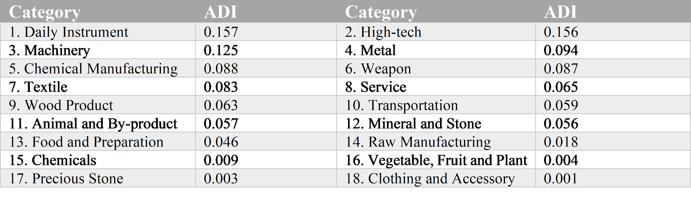
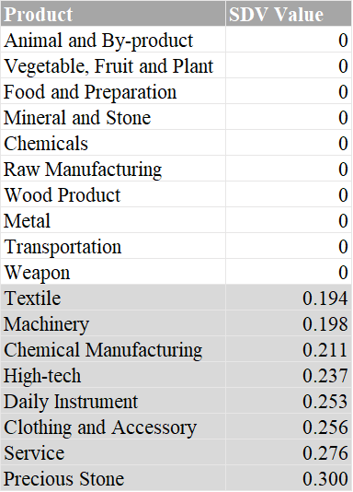
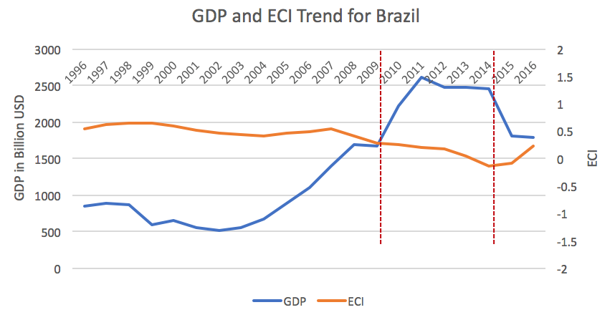
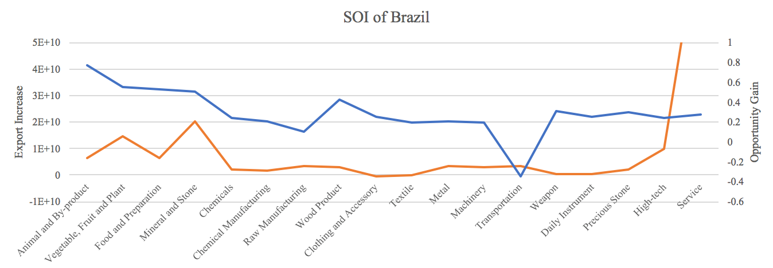
7.1 Brazil
Table 1: Actual Development Index (ADI)
Table 2: Suggested Development Vector (SDV)
SOI=0.8%

Slide 39
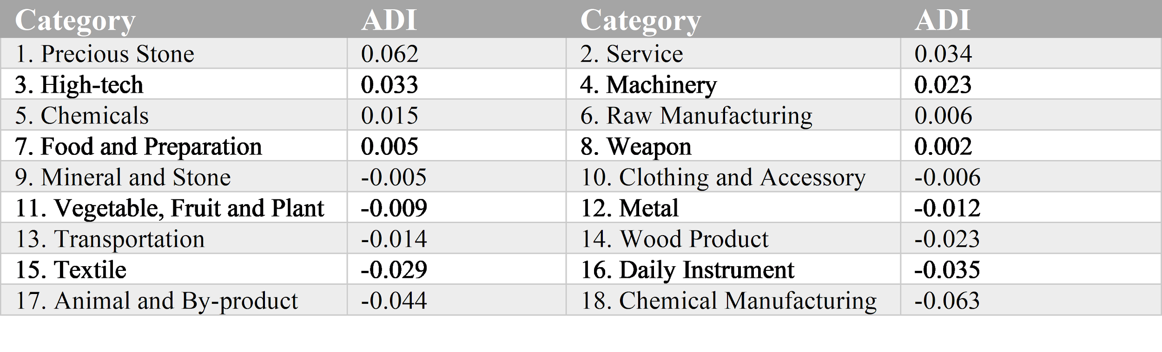
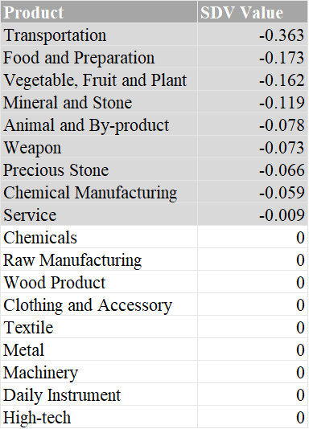
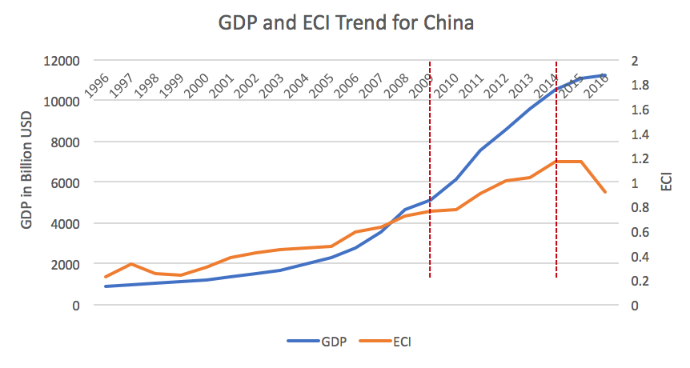
7.2 China
Table 1: Actual Development Index (ADI)
Table 2: Suggested Development Vector (SDV)

Slide 40
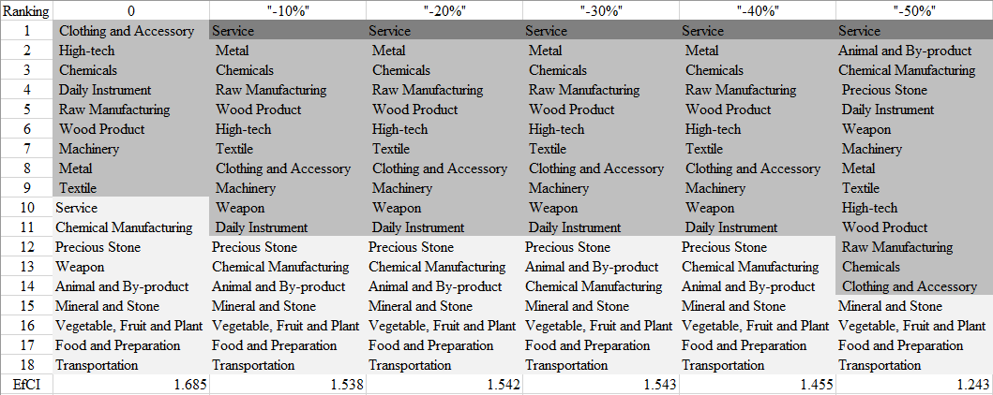
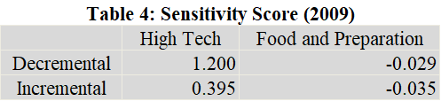
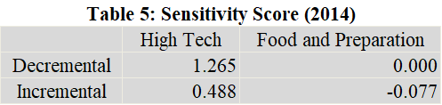
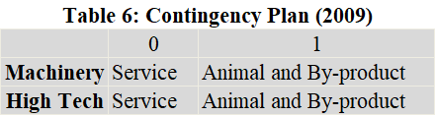
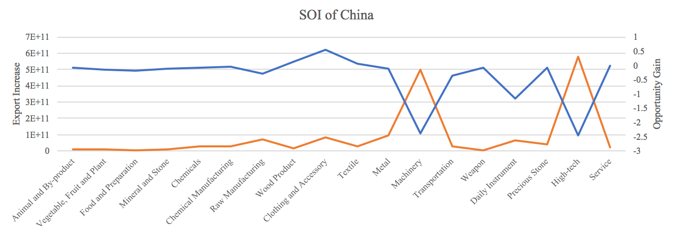
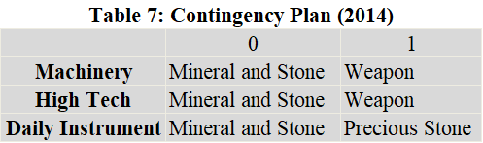
7.2 China
Table 3: High-tech Sensitivity Plan Table (2014)
SOI=82.8%

Slide 41
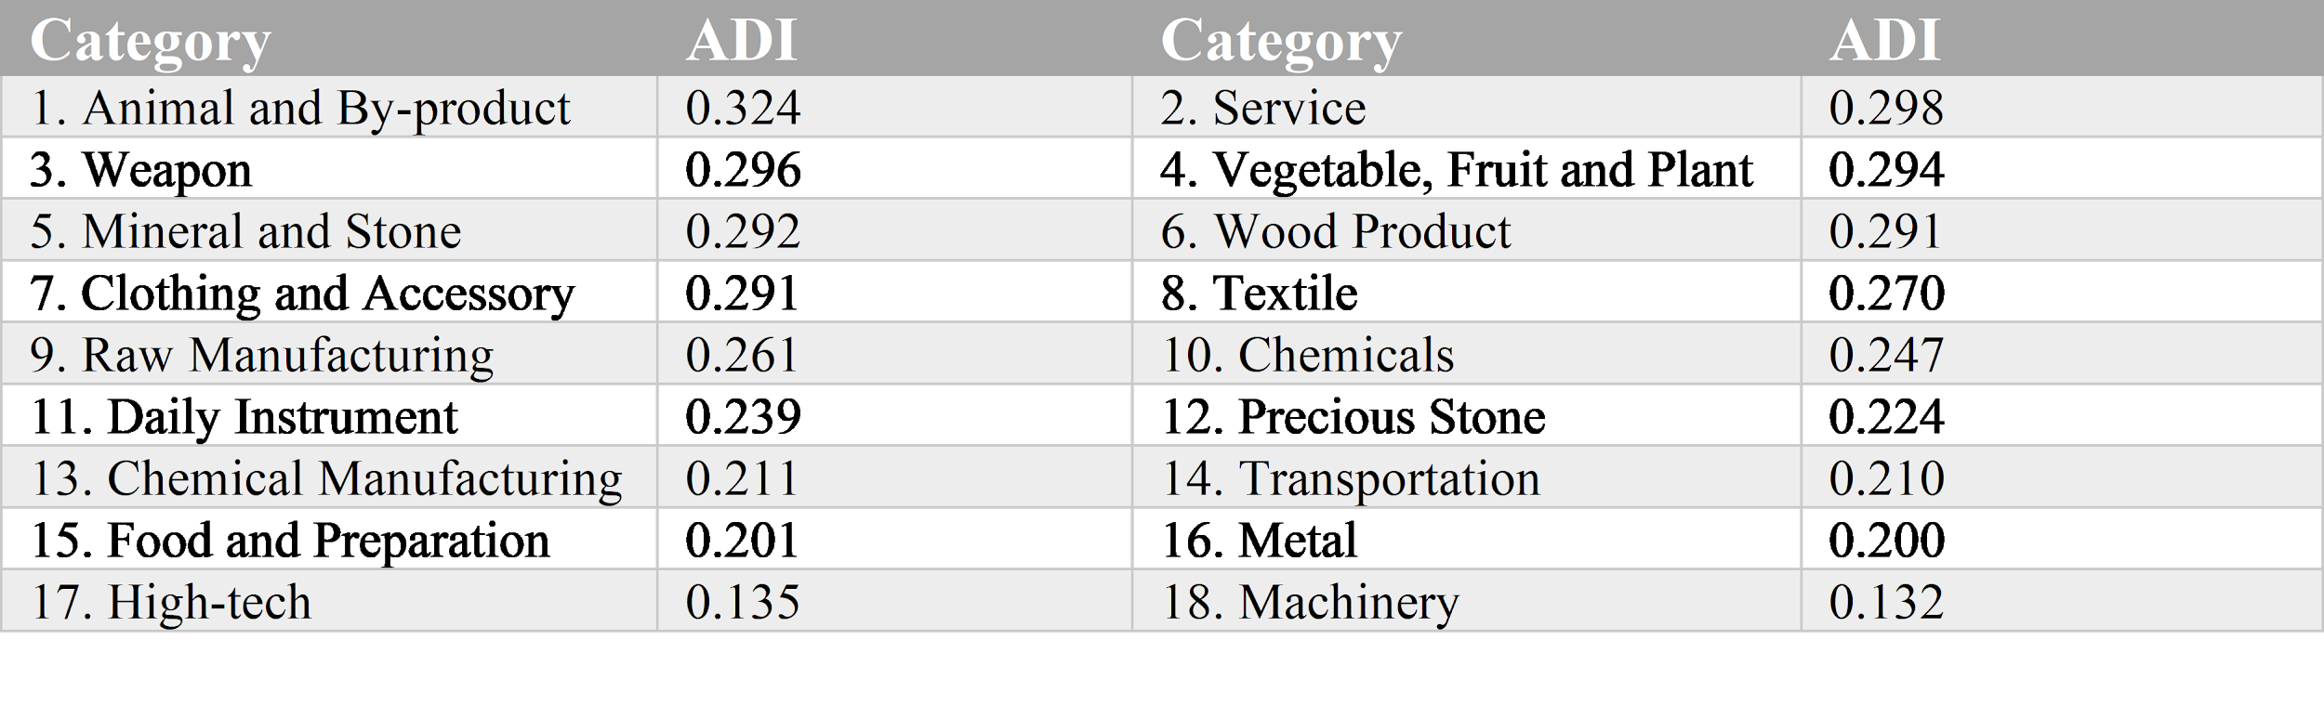
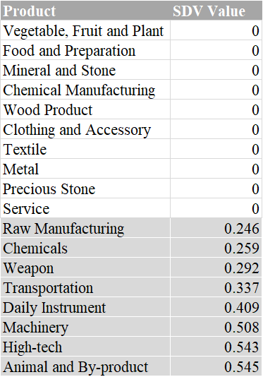
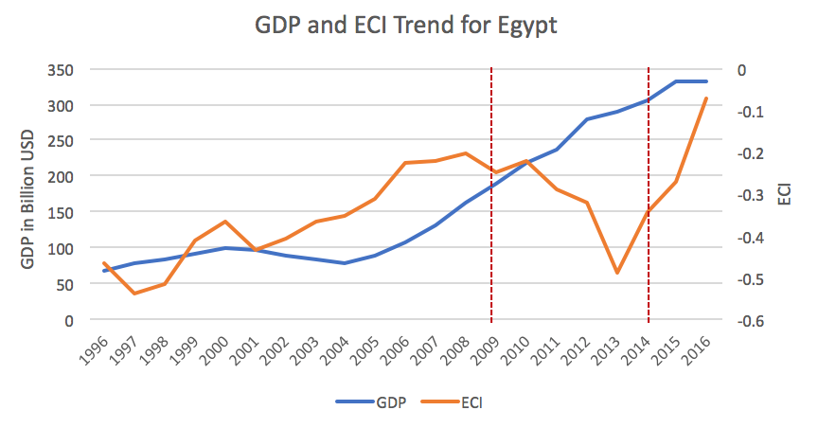
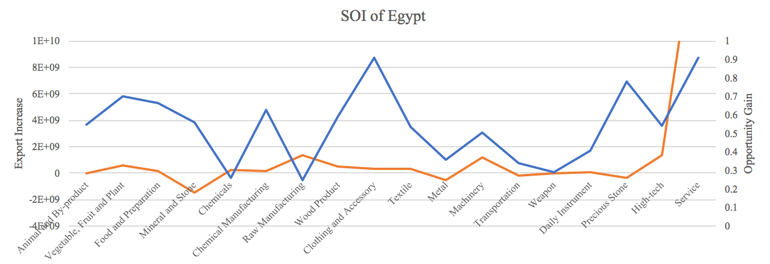
7.3 Egypt
Table 1: Actual Development Index (ADI)
Table 2: Suggested Development Vector (SDV)
SOI=19.2%

Slide 42
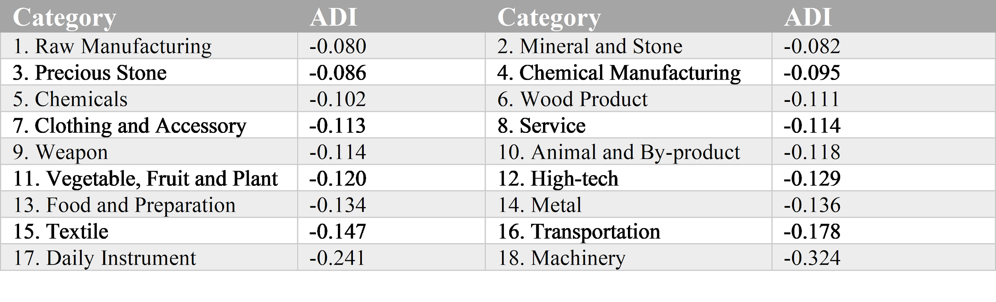
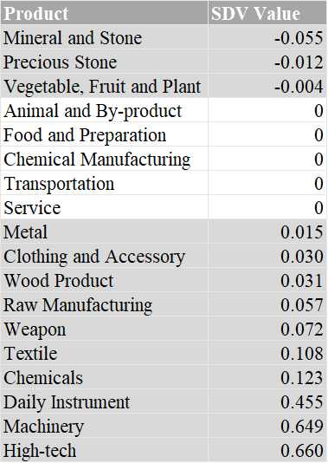
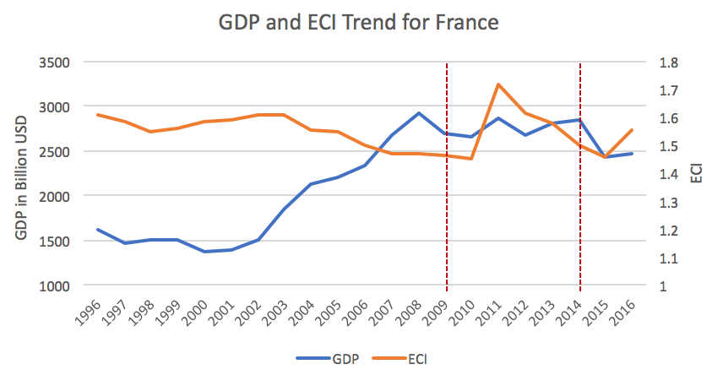
7.4 France
Table 1: Actual Development Index (ADI)
Table 2: Suggested Development Vector (SDV)

Slide 43
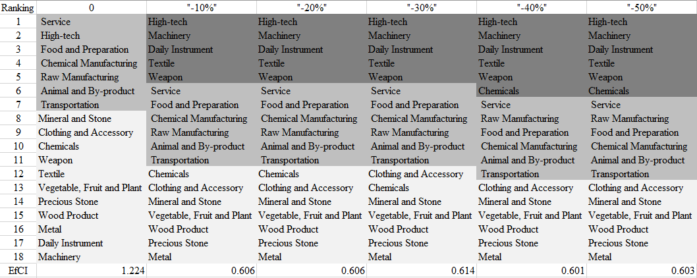
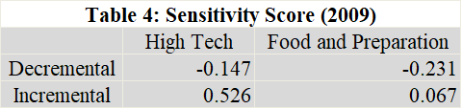
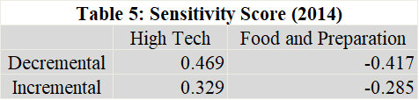
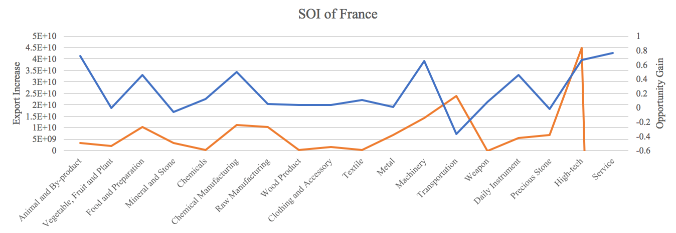
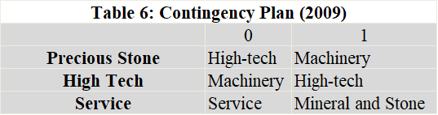
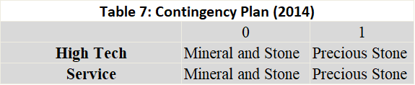
7.4 France
Table 3: High-tech Sensitivity Plan Table (2014)
SOI=14.2%

Slide 44
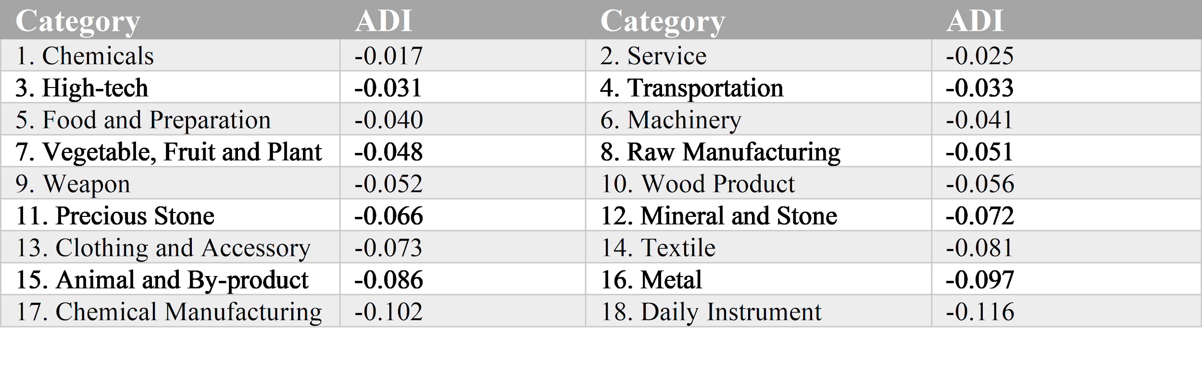
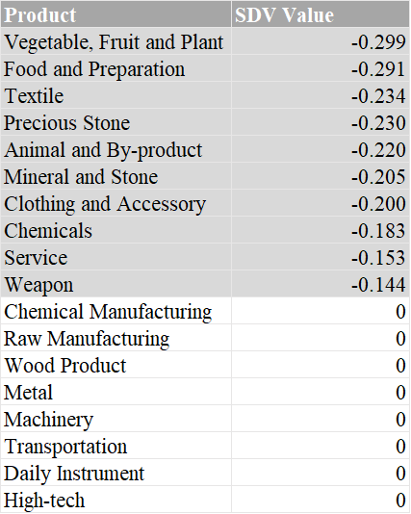
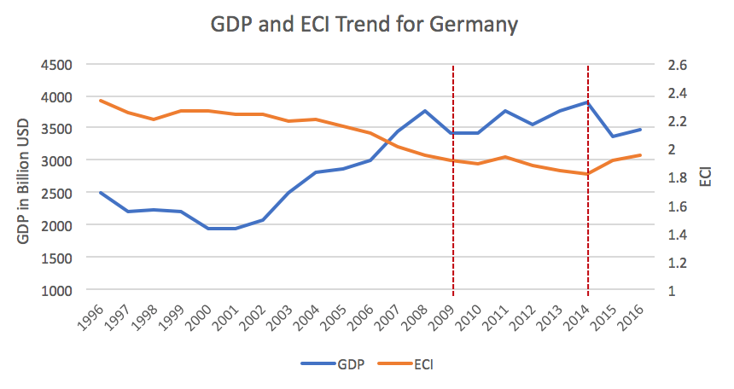
7.5 Germany
Table 1: Actual Development Index (ADI)
Table 2: Suggested Development Vector (SDV)

Slide 45
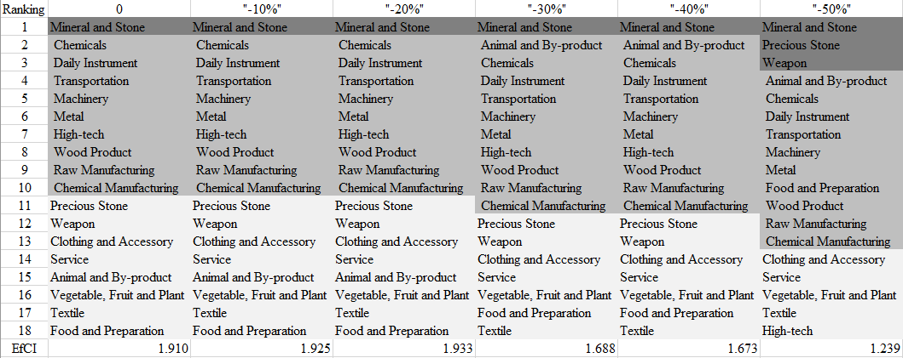
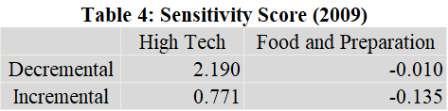
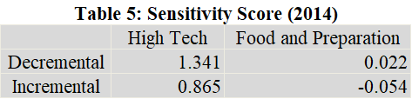



7.5 Germany
Table 3: High-tech Sensitivity Plan Table (2014)
SOI=19.4%

Slide 46



7.6 Japan
Table 1: Actual Development Index (ADI)
Table 2: Suggested Development Vector (SDV)

Slide 47




7.6 Japan
Table 3: High-tech Sensitivity Plan Table (2014)
SOI=58.3%

Slide 48



7.7 Malaysia
Table 1: Actual Development Index (ADI)
Table 2: Suggested Development Vector (SDV)

Slide 49





7.7 Malaysia
Table 3: High-tech Sensitivity Plan Table (2014)
SOI=10.2%

Slide 50



7.8 Mexico
Table 1: Actual Development Index (ADI)
Table 2: Suggested Development Vector (SDV)

Slide 51






7.8 Mexico
Table 3: High-tech Sensitivity Plan Table (2014)
SOI=68.3%

Slide 52




7.9 Morocco
Table 1: Actual Development Index (ADI)
Table 2: Suggested Development Vector (SDV)
SOI=29.7%

Slide 53




7.10 South Africa
Table 1: Actual Development Index (ADI)
Table 2: Suggested Development Vector (SDV)
SOI=1.3%

Slide 54



7.11 South Korea
Table 1: Actual Development Index (ADI)
Table 2: Suggested Development Vector (SDV)

Slide 55




7.11 South Korea
Table 3: High-tech Sensitivity Plan Table (2014)
SOI=48.3%

Slide 56




7.12 Spain
Table 1: Actual Development Index (ADI)
Table 2: Suggested Development Vector (SDV)
SOI=14.3%

Slide 57




7.13 Turkey
Table 1: Actual Development Index (ADI)
Table 2: Suggested Development Vector (SDV)
SOI=13.8%

Slide 58




7.14 United Arab Emirates
Table 1: Actual Development Index (ADI)
Table 2: Suggested Development Vector (SDV)
SOI=1.0%

Slide 59



7.15 USA
Table 1: Actual Development Index (ADI)
Table 2: Suggested Development Vector (SDV)

Slide 60






7.15 USA
Table 3: High-tech Sensitivity Plan Table (2014)
SOI=28.7%

